Slide 1
Order Statistics and Median Filtering
CSC382 Final Project
By Youssef M

Slide 2
def insertionSort(arr):
for i in range(1, len(arr)):
key = arr[i]
j = i - 1
while j >= 0 and key < arr[j]:
arr[j + 1] = arr[j]
j -= 1
arr[j + 1] = key
return arr
-sorts an array by iteratively inserting each element into its correct position in a sorted portion of the array.
Start with the second element (i = 1) since a single-element subarray is already sorted. For each element, compare it to the elements in the already sorted portion of the array (from right to left).Shift elements one position to the right if they are larger than the current element.Insert the current element in its correct position.
Insertion sort is very efficient for small arrays, which is why it’s used for sorting the groups of size 5 in the orderStatistics function.

Slide 3
(Base case for the recursive orderStatistics function) If the array has 5 or fewer elements, sort it using insertionSort and return the ith smallest element directly.
Sorting small arrays is simple and quick, avoiding unnecessary recursion when the input is small.
if len(arr) <= 5:
A = insertionSort(arr)
return A[i]
This divides the input array into groups of 5 and finds the median of each group.
Divide into Groups:Split the array into chunks of 5 elements at a time.
Sort Each Group:Sort each chunk using insertionSort. Extract Medians:From each sorted group, pick the middle element as the median.
These medians are used to compute the "median of medians," which becomes the pivot for partitioning.
groupsOf5 = []
j = 0
while j < len(arr):
groupsOf5.append(insertionSort(arr[j: j + 5]))
j += 5
medians = [group[len(group) // 2] for group in groupsOf5]

Slide 4
if len(medians) <= 5:
pivot = medians[len(medians) // 2]
else:
pivot = orderStatistics(medians, len(medians) // 2)
If the list of medians is small (5 or fewer), directly find the median.Otherwise, recursively find the median of medians using the orderStatistics function.
This ensures that the pivot is chosen wisely to balance the partitioning, improving efficiency.
Divides the input array into three parts relative to the pivot:
low: Elements smaller than the pivot
high: Elements larger than the pivot.
middle: Elements equal to the pivot.
This partitioning step allows the algorithm to decide in which part the desired ith element lies, reducing the problem size for the next recursive step.
low = [x for x in arr if x < pivot]
high = [x for x in arr if x > pivot]
middle = [x for x in arr if x == pivot]

Slide 5
if i < len(low):
return orderStatistics(low, i)
elif i < len(low) + len(middle):
return pivot
else:
return orderStatistics(high, i - len(low) - len(middle))
Determines in which partition (low, middle, or high) the ith element lies:If i is less than the size of low, recursively search in low.If i is within the size of low plus middle, the ith element is the pivot.Otherwise, search in high, adjusting i for the offset caused by the elements in low and middle.
This divide-and-conquer strategy ensures that each step processes a smaller portion of the array, leading to efficient execution.
for n in range(len(sampleSizeN)):
for popN in range(len(populationSizeN)):
for ith in range(5):
i = random.randint(0, sampleSizeN[n])
start = time.process_time()
theIthNum = orderStatistics(theArray, i)
end = time.process_time()
Iterates through combinations of sample sizes and population sizes to test the orderStatistics function.For each test:Picks a random index i. Measures the time taken to find the ith element.
Provides evidence of the function's performance under different conditions.

Slide 6
This method uses a deterministic approach and has a time complexity of O(n).
Splitting the array into groups of 5 takes O(n)
Sorting each group and finding their medians is O(n) since the groups are constant-sized.
Finding the median of medians ensures the pivot splits the array into roughly balanced partitions.
Splitting into smaller, equal, and larger groups based on the pivot also takes O(n).

Slide 7
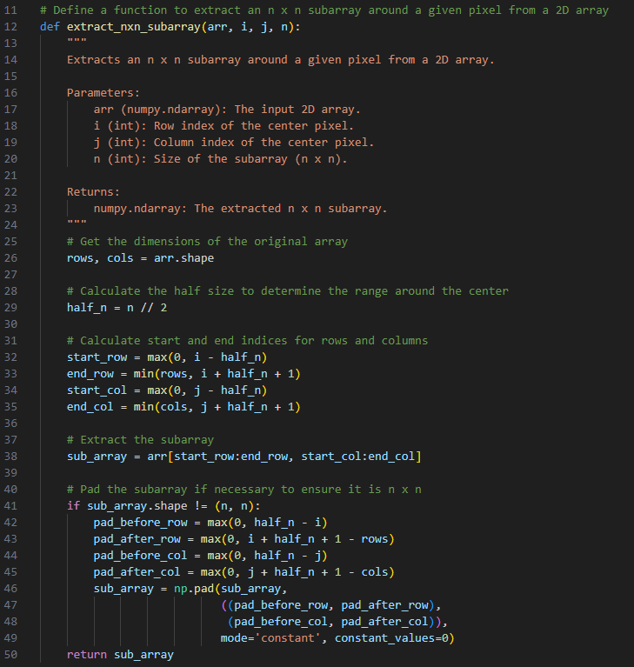
Now lets take a look at median filtering!
Extracts an n×n subarray centered around a given pixel (i,j) from a 2D array (image).
Calculates the range of rows and columns around the pixel, ensuring they don’t exceed image boundaries.
Extracts the subarray from the image using the calculated indices.
Pads the subarray with zeros if the pixel is near the edge and the subarray would otherwise be incomplete.
Ensures that filtering can be applied consistently even for edge pixels, where neighborhoods may not fit fully within the image.

Slide 8
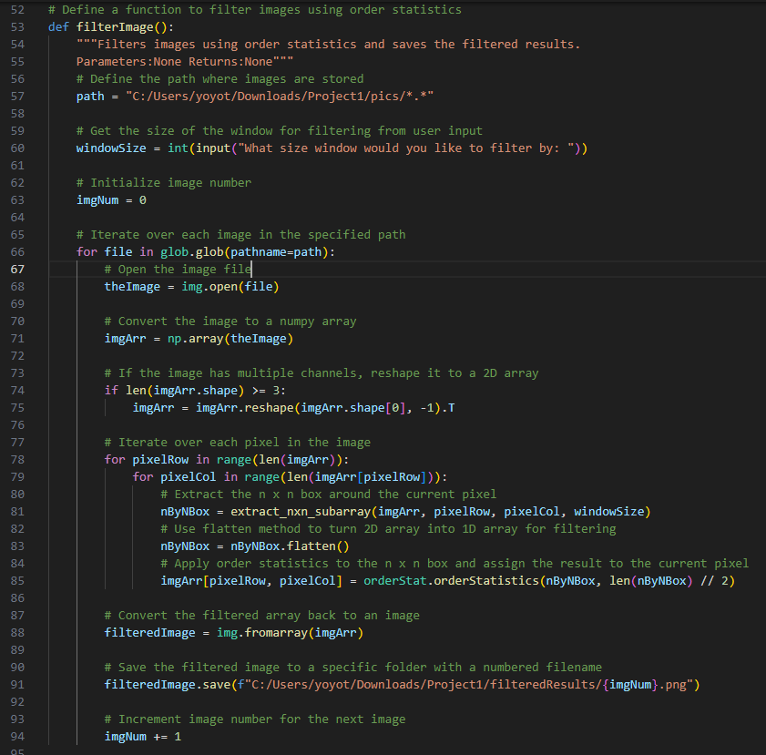
Set Up File Paths and Window Size: The path variable specifies the folder containing images to filter. The user inputs the desired n×n window size for the median filter.
Load Images: Iterates through all image files in the specified folder using glob. Opens each image and converts it into a numpy array for pixel-level processing.If the image has multiple channels (e.g., RGB), reshapes it to work as a 2D grayscale array for simplicity.
Pixel-by-Pixel Processing: Loops through every pixel in the image. For each pixel: Extracts an n×n subarray centered around the pixel using extract_nxn_subarray. Flattens the subarray into a 1D array. Uses the orderStatistics function to find the median of the subarray and assigns it to the current pixel. Save Filtered Images: Converts the processed numpy array back into an image. Saves the filtered image in a designated output folder, assigning a unique filename based on imgNum.

Slide 9
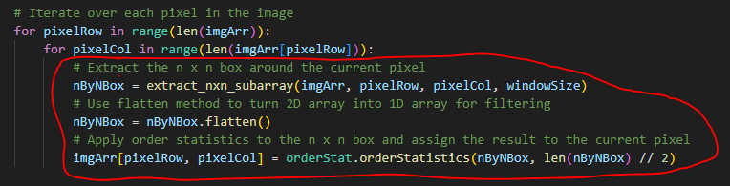
Extracts an n×n neighborhood around the current pixel using extract_nxn_subarray. Converts the neighborhood into a 1D array using flatten() to simplify operations. Uses orderStatistics to calculate the median of the neighborhood, which is the “length of subarray / 2”-th smallest element. Replaces the pixel value with the median.
The median filter smooths the image while preserving edges by replacing each pixel with the median of its neighborhood.

Slide 10
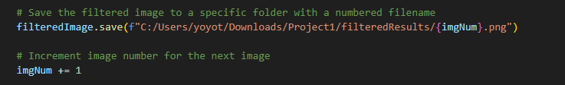
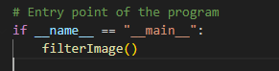
Extracts an n×n neighborhood around the current pixel using extract_nxn_subarray. Converts the neighborhood into a 1D array using flatten() to simplify operations. Uses orderStatistics to calculate the median of the neighborhood, which is the “length of subarray / 2”-th smallest element. Replaces the pixel value with the median.
The median filter smooths the image while preserving edges by replacing each pixel with the median of its neighborhood.
Converts the processed numpy array back to an image using img.fromarray. Saves the image to a designated folder with a unique filename.
Ensures that each processed image is saved for later viewing and analysis, without overwriting previous results.
Ensures that the filterImage function runs only when the script is executed directly, not when it’s imported as a module.This is a common practice in Python to improve code reusability.

Slide 11
Summary of the key steps for median filtering code: Extract Neighborhood: extract_nxn_subarray handles edge cases for n×n windows.
Median Calculation: Uses orderStatistics to compute the median for each pixel’s neighborhood.
Pixel-by-Pixel Processing: Applies the median filter across the entire image.
Save Results: Writes the filtered image to an output folder.
Next we will go over the median filtering time complexity:

Slide 12
The time complexity for this median filtering code is:
O(w * h * n^2)
w*h is for the image dimensions, this code processes every pixel in the image, iterating over its width (w) and height (h).
For each pixel, it extracts an n * n , aka n^2, subarray which involves O(n^2) operations.
Finding the median of the subarray using orderStatistics also takes O(n^2) because the orderStatistics function provesses the n^2 elements in the subarray to find the median. Since it uses the Median of Medians algorithm, this step is also O(n^2).
For each pixel its O(n^2)
For the entire image though, its O(w*h*n^2).

Slide 13
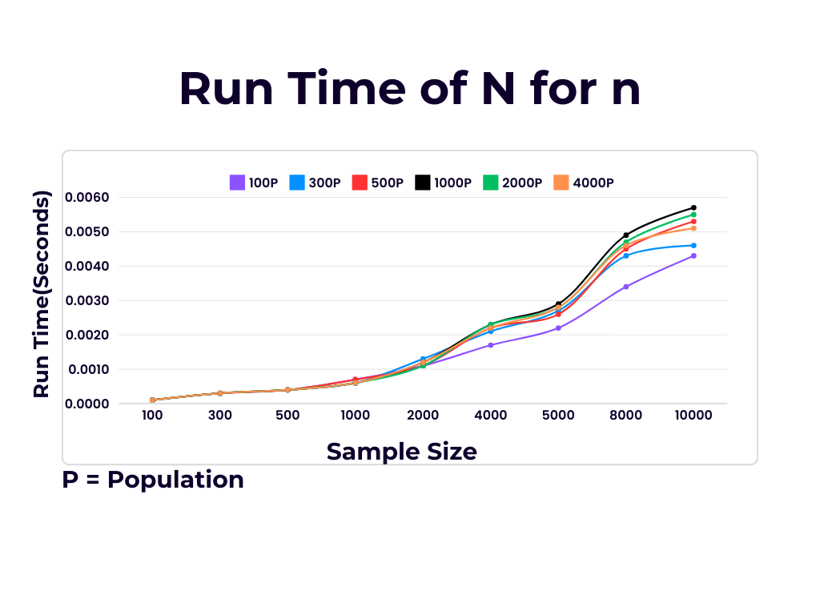
Order Statistic Algorithm
Run Time for all combination of n and N.
https://www.canva.com/design/DAF9L9m6cMk/Tj1pmhV5qKzXluBXy5g3gg/edit

Slide 14
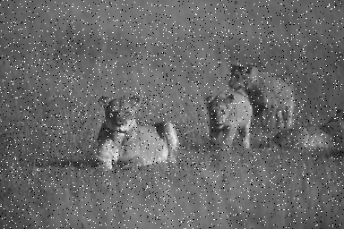
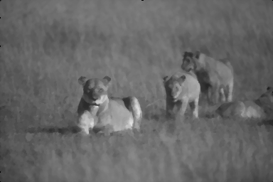
Results For Median Filtering Images
-used .png files for this project that I found online and using Python libraries such as: Python Imaging Library: to extract images and save images Numpy: to turn the image into a numpy array that we can run our order stat algorithm on glob: to access my files and operating system
->

Slide 15
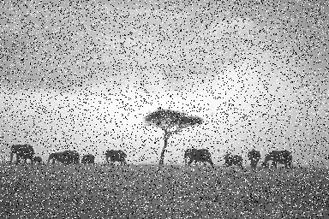
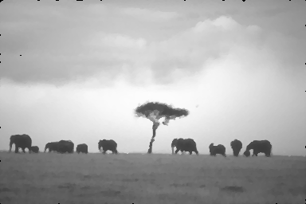
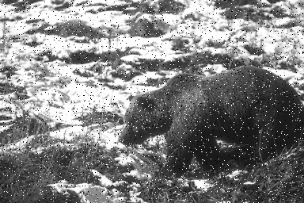
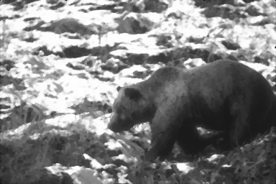
->
->

Slide 16
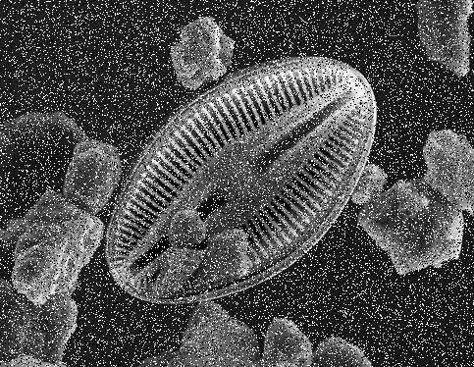
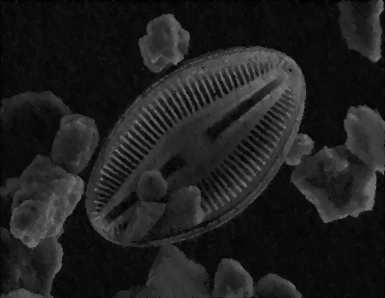
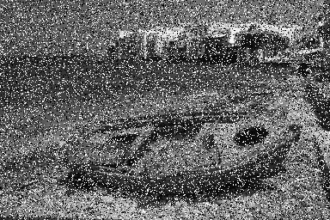

->
->

Slide 17
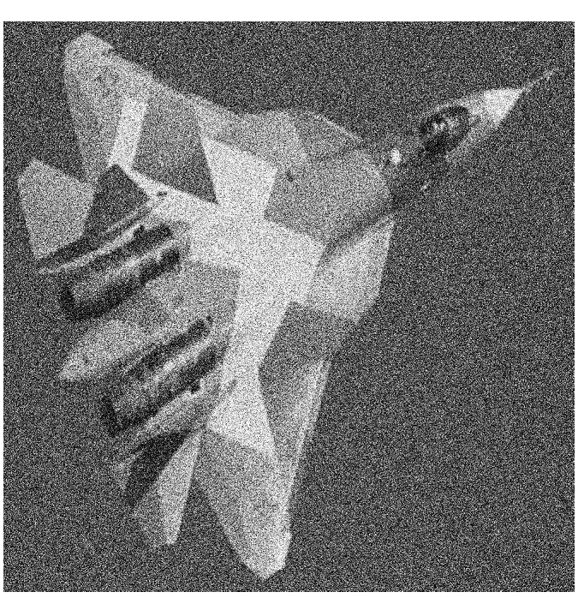

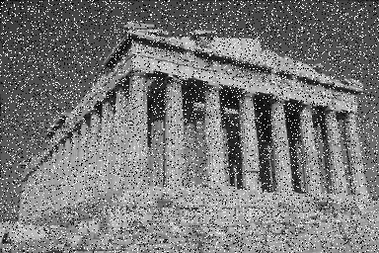

->
->

Slide 18
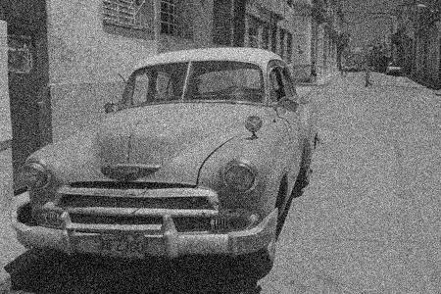

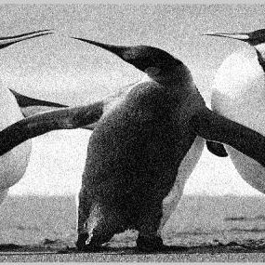

->
->

Slide 19
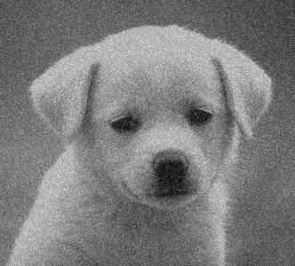
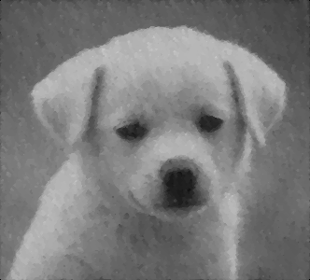
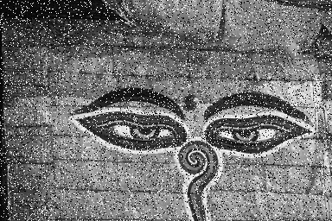
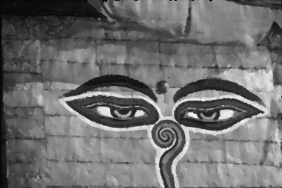
->
->

Slide 20
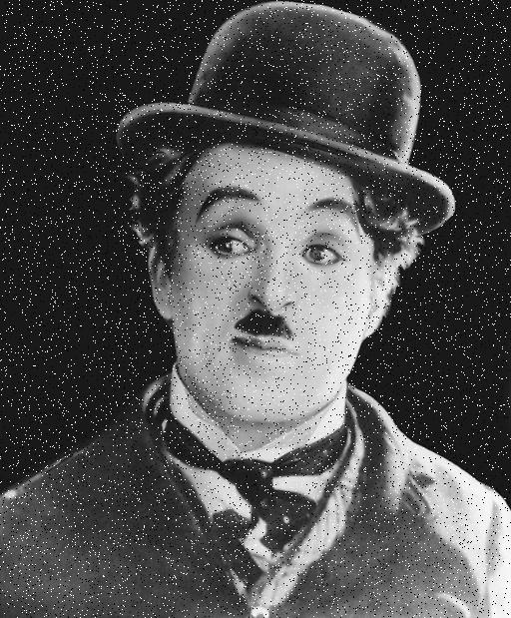

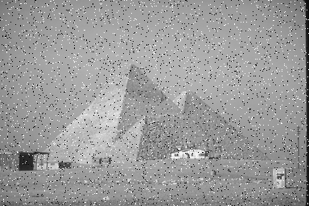
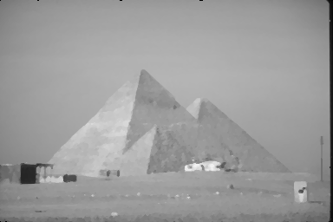
->
->

Slide 21
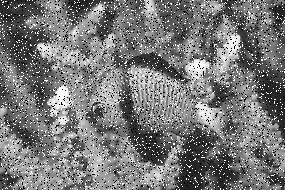

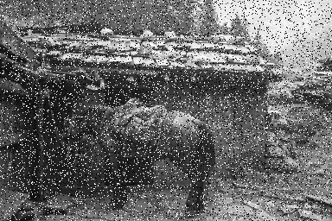
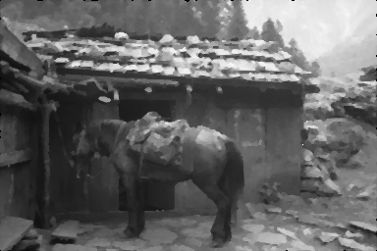
->
->

Slide 22
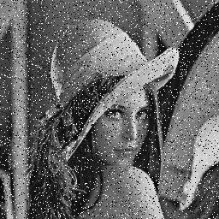
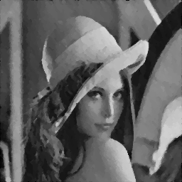
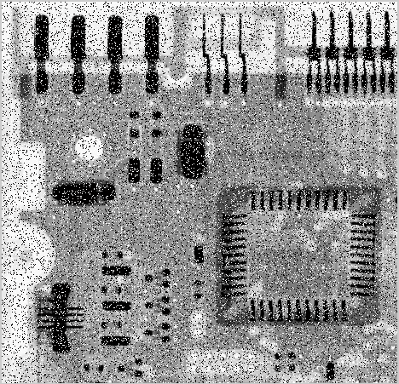
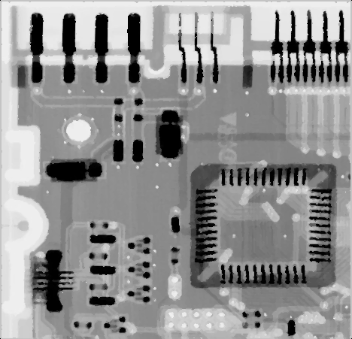
->
->

Slide 23
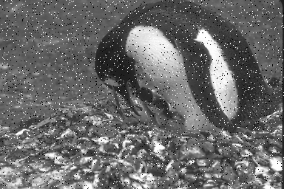
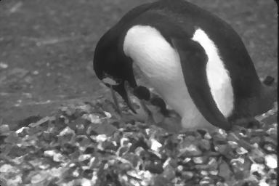
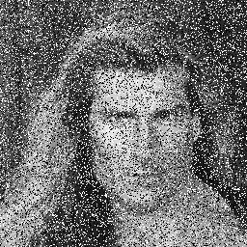

->
->

Slide 24



